Slide 1
Network Utility Maximization with Heterogeneous Traffic Flows
Abhishek Sinha*, Eytan Modiano
Presented by
Rajat Talak
*Qualcomm Research, MIT
WiOpt 2018
Shanghai, China

Slide 2
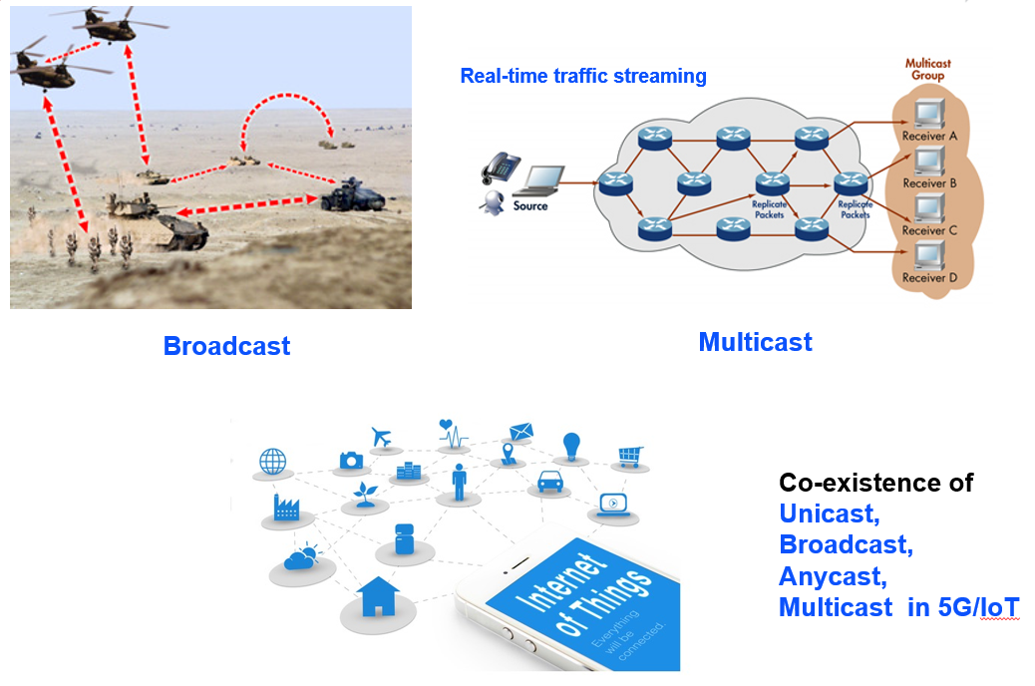
Motivation
Networks with Heterogeneous traffic
IoT and 5G
Problem: Design an routing, link scheduling, packet replication, and admission control policy that maximizes the total utility while keeping the packet queues stable.

Slide 3
Introduction
We consider the NUM problem with heterogeneous traffic
Packets may belong to different concurrent sessions including unicast, broadcast, multicast, or anycast.
No efficient and utility optimal policy is known apart from the unicast traffic (Backpressure algorithm [Tassiulas et al ’92])
No per-node flow conservations because of packet duplications
Our contribution:
A generic algorithmic paradigm called Universal Max Weight (UMW+), that efficiently solves the NUM problem with concurrent flows.

Slide 4
Universal Max Weight
Previous work:
Abhishek Sinha, Eytan Modiano, “Optimal Control for Generalized Network-Flow Problems,” IEEE Trans. Netw., Feb. 2018
Queue stability problem
Arrival rate is within the throughput region
No admission control
No utility maximization
End this slide with:
I will first discuss the optimal control algorithm, and then show how admission control and utility maximization is brought into it, to solve this next problem.
Routing, scheduling, and
packet replication
This work:
Arrivals may not be in the throughput region
Network Utility Maximization (NUM)
Admission control + Queue stability
Admission control

Slide 5
System Model
Multi-hop wireless network G(V, E) with point-to-point links subject to wireless interference
At every slot, only a subset of links (e.g., Matching) may be activated
Infinitely backlogged traffic: An Admission Controller admits packets from each flow k at every slot. Source k derives utility for admission rate r.
Packet Queueing
Packets may queue up for crossing links
Link states may be time-varying i.i.d. ON/OFF
1
4
3
2
6
5
7
8

Slide 6
Traffic Model: Generalized Flow
Traffic Classes: Class k has utility-rate function
Single source node S^{k}
One of more destination node(s) D^{k}
Unicast: Single source, single destination
Multicast: Single source, multiple destinations
Broadcast: Single source, all destinations
Anycast: Single source, choice of one among alternative destinations

Slide 7
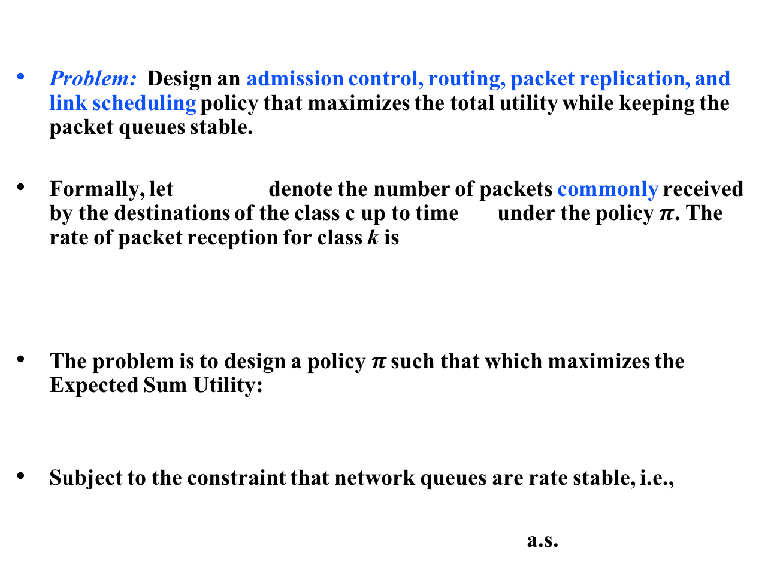
Formal NUM Problem
Problem: Design an admission control, routing, packet replication, and link scheduling policy that maximizes the total utility while keeping the packet queues stable.
Formally, let denote the number of packets commonly received by the destinations of the class c up to time under the policy $π$. The rate of packet reception for class k is
The problem is to design a policy$π$ such that which maximizes the Expected Sum Utility:
Subject to the constraint that network queues are rate stable, i.e.,
a.s.
Abhishek: Can you replace k with c?

Slide 8
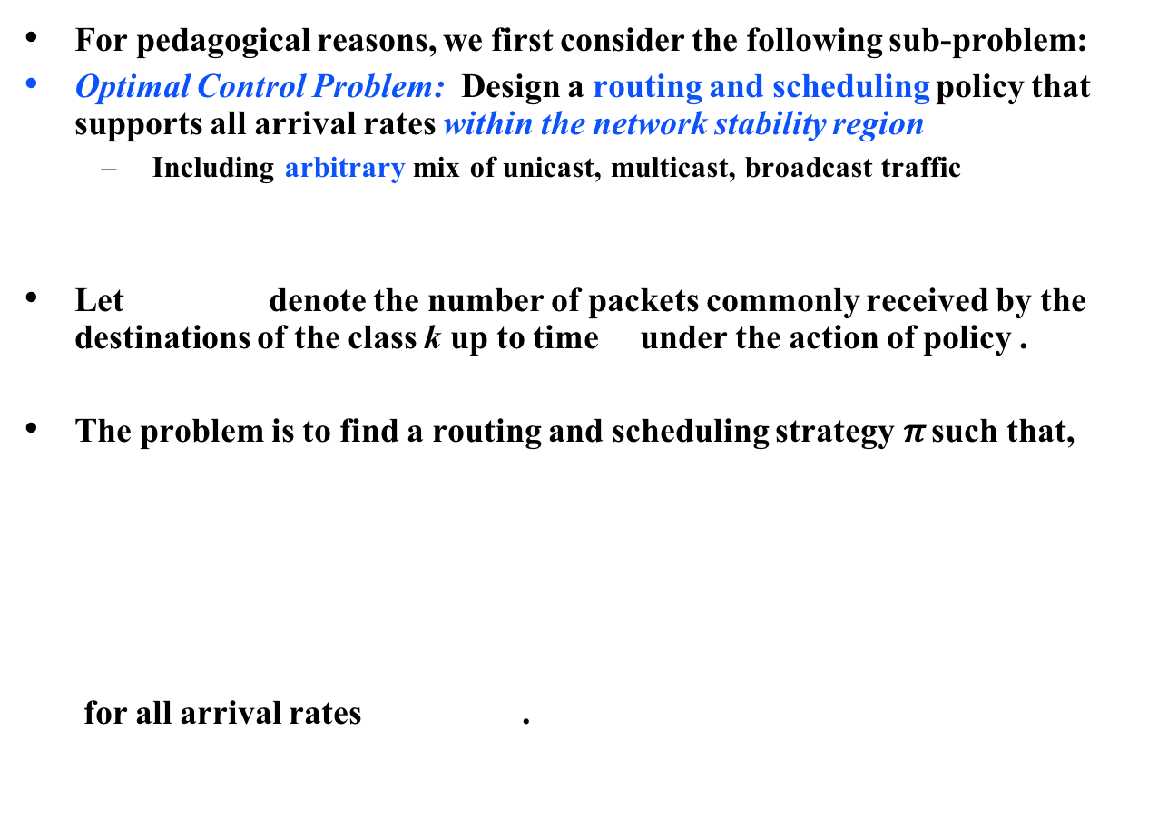
The Optimal Control Sub-Problem
For pedagogical reasons, we first consider the following sub-problem:
Optimal Control Problem: Design a routing and scheduling policy that supports all arrival rates within the network stability region
Including arbitrary mix of unicast, multicast, broadcast traffic
Let denote the number of packets commonly received by the destinations of the class k up to time under the action of policy .
The problem is to find a routing and scheduling strategy$π$ such that,
for all arrival rates .

Slide 9
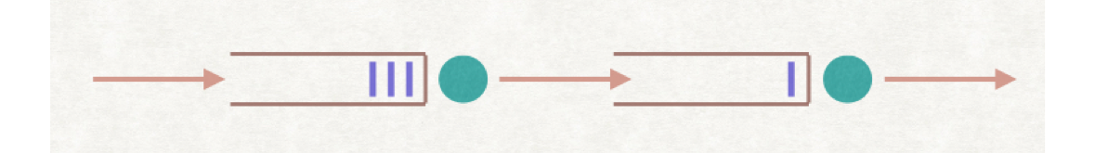
Design of UMW: Challenges and Insight
Due to interdependent arrivals, networked queues are harder to analyze and control
We obtain a simpler virtual system of queues by relaxing the Precedence constraints as described next
Link 1
Link 2
Source
Destination
iid arrivals
correlated arrivals
This path is a tree for broadcast
Abhishek: which arrivals are correlated here?
Notes:
The arrivals to the second queue.

Slide 10
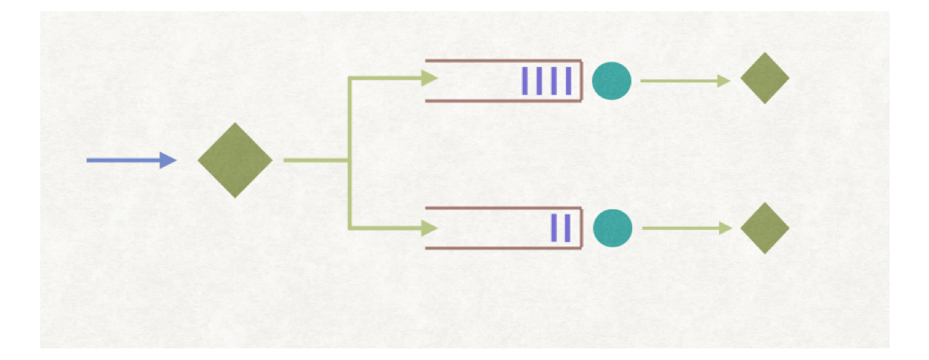
Precedence Relaxed System
As an example, consider a two-hop network
The packet p must traverse Link 1 before crossing Link 2 (Precedence)
Equivalent virtual queue system
Packet arrives to both queues simultaneously (No precedence constraint)
Link 1
Link 2
p
This path is a tree for broadcast
p
p
p

Slide 11
Dynamics of the Virtual Queues
Define the controlled arrival vector to the virtual queue to be
where the controlled variable denotes number of virtual packet arrival at the virtual queue at time t
Let be the (controlled) departures from virtual queue at time t
The virtual Queues evolve according to the Lindley recursions:
Unlike the original system, given the controls, the virtual queues are independent of each other, making their control and analysis tractable
Abhishek: This light green color is not visible

Slide 12
Derivation of the VQ Stabilizing Policy
Define a Lyapunov function quadratic in the virtual queue lengths
The one-slot drift of under policy is given by,
where and are respectively routing and activations chosen by the policy
The drift upper-bound has a nice separable form and may be minimized over the feasible controls separately
Abhishek: Where is class c?
Notes:
A(t) denote the total arrivals from all classes at slot t. So no need to mention individual class c.

Slide 13
Optimal Control: Routing
Minimizing the upper-bound on drift over the routing action, we get the following general route selection policy at time t
Special Cases:
Unicast: Shortest path in the weighted graph
Broadcast: Minimum weight Spanning Tree in
Multicast: Minimum weight Steiner tree in , connecting the source node to the destination nodes
Anycast: The Shortest of the all paths in the weighted graph

Slide 14
Optimal Control: Link Scheduling
Similarly, minimizing the upper-bound drift for link-scheduling actions, we get the following activation policy:
(Max-Weight activation, using virtual queue length)
Example: For wireless networks with Primary interference constraints the above problem reduces to finding a Max-Weight-Matching in the weighted graph
Abhishek: Can you replace Q with virtual queue length?
b
10
15
a
7
d
5
c
8
Notes:
Done!

Slide 15
Theorems: Virtual Queue Stability
Theorem [Strong Stability of the VQs]: Under the UMW routing and link scheduling scheme, the VQs are strongly stable:
This leads to the following sample path result:
Theorem [Almost sure bound]: Under UMW the VQs at time t are bounded as follows

Slide 16
Packet Scheduling for Physical Network
How do we decide which packet to transmit over a link at any given time slot?
Why does it matter? Can’t we just use FCFS?
Extended Nearest to Origin policy (ENTO): When multiple packets contend for an edge, schedule the one which has traversed the least number of edges
Extension of NTO (Gamarnik, ‘98) for an adversarial setting
Theorem [Stability of the Physical Queues] : The overall UMW policy is throughput-optimal.

Slide 17
Remaining Piece: Admission Control
Multi-hop wireless network G(V, E)
Interference, packet queueing, channel process as before
Infinitely backlogged traffic: An Admission Controller admits packets from each flow k at every slot. Source k derives utility for admission rate r.
1
4
3
2
6
Abhishek: Can you replace k with c?
5
7
8
Abhishek: what if you relax the infinitely backlogged assumption, i.e., you have less packets than your admission controller seeks at certain times?
- Anticipating such a question. Would like to know the answer.

Slide 18
Drift Plus Penalty on the VQs
Define a Potential function which is quadratic in the virtual queue lengths
The drift plus penalty may be upper-bounded from the dynamics as
where and are routing and activations chosen by the policy
This upper-bound has a nice separable form and may be minimized over admission control, routing, and scheduling separately.
Notes:
Sum of k

Slide 19
Optimal Control: Admission Controller
By minimizing the upper-bound on the drift plus penalty expression, we obtain the following admission control policy:
Admit packets from class k at time t where
where is the cost of the shortest path for class k computed in the previous slide, i.e.,
Abhishek: Class c or k?
Notes:
Say class k

Slide 20
Theorems: Utility Optimality and Queue Stability
Theorem 1: Let denote the optimal solution of the NUM problem.
Then under the action of the UMW+ policy
(1) The Virtual Queues are rate stable
(2) UMW+ achieves a utility of at least
Proof of Stability of the physical queues follows the same line of argument as before.

Slide 21
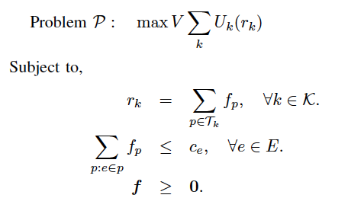
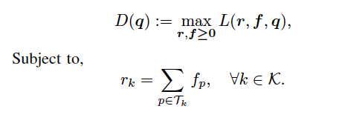
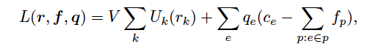
Connection with Duality
Consider a static version of the NUM flow decomposition problem (P) and its Dual function (D):
Primal
(Flow Decomposition)
(Capacity Constraint)
Dual Function (D):
Where

Slide 22
Connection with Duality
Consider a static version of the NUM flow decomposition problem (P) and its Dual function (D):
Primal
(Flow Decomposition)
(Capacity Constraint)
Sub-gradient descent for the dual is “equivalent” to the UMW+ policy
Dual Function (D):
Where

Slide 23
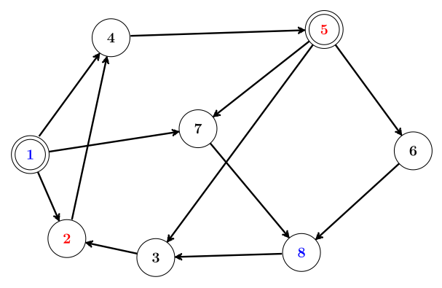
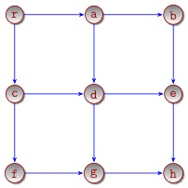
Simulation Results (Unicast)
Heuristic UMW policy: UMW with actual Physical Queue-lengths
Unicast Flows: 1->8, 5->2
Broadcast Flows: source r
Simulated Networks

Slide 24
UMW+ Performance for Unicast Flows (Static Network)
Utility
Queue Lengths
Utility vs Queue Length Tradeoff for Unicast Traffic
with Varying V parameter in a static network

Slide 25
UMW+ Performance for Broadcast Flows (Dynamic Network)
Utility vs Queue Length Tradeoff for Broadcast Traffic
with Varying V parameter in a dynamic network

Slide 26
Conclusion
Thank you
Questions?

